Slide 1
Programming Fundamentals
By
Shazmeen Batool

Slide 2
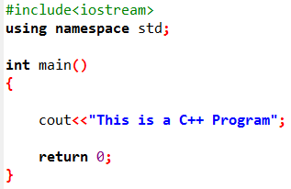
Task
Print the message "This is a C++ program" on one line.

Slide 3
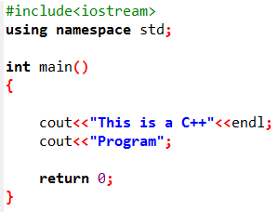
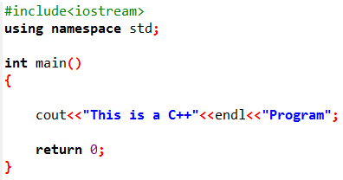
Task
Print the message "This is a C++ program" on two lines. End the first line with C++.

Slide 4
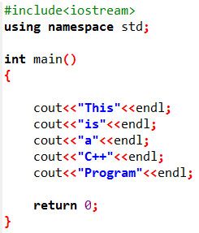
Task
Print the message "This is a C++ program" with each word on a separate line.

Slide 5
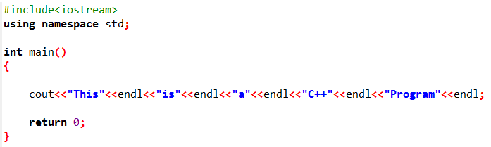
Task
Print the message "This is a C++ program" with each word on a separate line.

Slide 6
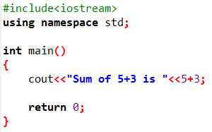
Task
Write a C++ program that evaluate “5+3” and display result on screen.

